Slide 1
Abstract class in Java

Slide 2
Abstract Class
A class that is declared with abstract keyword, is known as abstract class in java. It can have abstract and non-abstract methods (method with body).
Before learning java abstract class, let's understand the abstraction in java first.

Slide 3
Abstraction in Java
Abstraction is a process of hiding the implementation details and showing only functionality to the user.
Another way, it shows only important things to the user and hides the internal details for example sending sms, you just type the text and send the message. You don't know the internal processing about the message delivery.
Abstraction lets you focus on what the object does instead of how it does it.

Slide 4
Ways to achieve Abstraction
There are two ways to achieve abstraction in java
Abstract class (0 to 100%)
Interface (100%)

Slide 5
Abstract class in Java
A class that is declared as abstract is known as abstract class. It needs to be extended and its method implemented. It cannot be instantiated.
Example of abstract class
abstract class A{}

Slide 6
Abstract Method
A method that is declared as abstract and does not have implementation is known as abstract method.
Example of abstract method
abstract void printStatus();//no body and abstract

Slide 7
Example of abstract class that has abstract method
abstract class Bike{
abstract void run();
}
class Honda4 extends Bike{
void run(){System.out.println("running safely..");}
public static void main(String args[]){
Bike obj = new Honda4();
obj.run();
}
}
Output
running safely..

Slide 8
Example 2:TestBank.java
class TestBank{
public static void main(String args[]){
Bank b;
b=new SBI();
System.out.println("Rate of Interest is: "+b.getRateOfInterest()+" %");
b=new PNB();
System.out.println("Rate of Interest is: "+b.getRateOfInterest()+" %");
}}
abstract class Bank{
abstract int getRateOfInterest();
}
class SBI extends Bank{
int getRateOfInterest(){return 7;}
}
class PNB extends Bank{
int getRateOfInterest(){return 8;}
}
Output
Rate of Interest is: 7 %
Rate of Interest is: 8 %

Slide 9
Abstract class
Abstract class have constructor, data member, methods etc.
An abstract class can have data member, abstract method, method body, constructor and even main() method.

Slide 10
TestAbstraction2.java
class Honda extends Bike{
void run(){System.out.println("running safely..");}
}
class TestAbstraction2{
public static void main(String args[]) {
Bike obj = new Honda();
obj.run();
obj.changeGear(); }
}
//example of abstract class that have method body
abstract class Bike
{
Bike(){System.out.println("bike is created");}
abstract void run();
void changeGear()
{
System.out.println("gear changed"); }
}
output
bike is created
running safely..
gear changed

Slide 11
RULES
Rule: If there is any abstract method in a class, that class must be abstract.
class Bike12
{
abstract void run();
}

Slide 12
Rule: If you are extending any abstract class that have abstract method, you must either provide the implementation of the method or make this class abstract.

Slide 13
Interface in Java

Slide 14
Interface
An interface in java is a blueprint of a class. It has static constants and abstract methods.
The interface in java is a mechanism to achieve abstraction.
There can be only abstract methods in the java interface not method body. It is used to achieve abstraction and multiple inheritance in Java.
Java Interface also represents IS-A relationship. It cannot be instantiated just like abstract class.

Slide 15
Why use Java interface?
There are mainly three reasons to use interface. They are given below.
It is used to achieve abstraction.
By interface, we can support the functionality of multiple inheritance.
It can be used to achieve loose coupling.

Slide 16
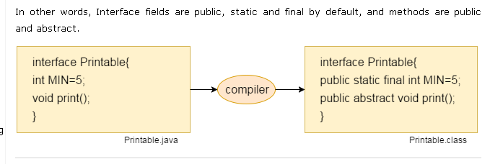
Internal addition by compiler
The java compiler adds public and abstract keywords before the interface method. More, it adds public, static and final keywords before data members.

Slide 17
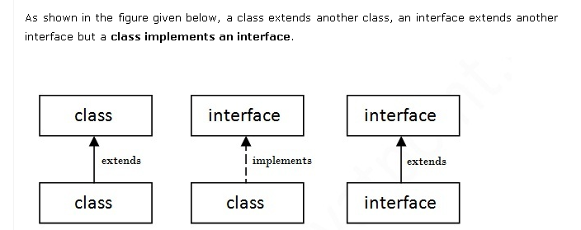
Understanding relationship between classes and interfaces

Slide 18
Java Interface Example: Drawable
//Interface declaration: by first user
interface Drawable{
void draw();
}
//Implementation: by second user
class Rectangle implements Drawable{
public void draw(){System.out.println("drawing rectangle");
}
}
class Circle implements Drawable{
public void draw(){System.out.println("drawing circle");}
}
//Using interface: by third user
class TestInterface1{
public static void main(String args[]){
Drawable d=new Circle();//In real scenario, object is provided by method e.g. getDrawable()
d.draw();
}}

Slide 19
Difference between abstract class and interface
Abstract class | Interface
1) Abstract class can have abstract and non-abstract methods. | Interface can have only abstract methods. Since Java 8, it can have default and static methods also.
2) Abstract class doesn't support multiple inheritance. | Interface supports multiple inheritance.
3) Abstract class can have final, non-final, static and non-static variables. | Interface has only static and final variables.
4) Abstract class can provide the implementation of interface. | Interface can't provide the implementation of abstract class.
5) The abstract keyword is used to declare abstract class. | The interface keyword is used to declare interface.
6) Example: public abstract class Shape{ public abstract void draw(); } | Example: public interface Drawable{ void draw(); }

Slide 20
Questions
Can abstract class have constructors in Java?
Can abstract class implements interface in Java?
does they require to implement all methods? Can abstract class be final in Java?
What will happen if we define a concrete method in an interface?
What will happen if we not initialize variables in an interface
Can we create object for an interface?

Slide 21
End of Session – 10B Thank You !

